Slide 1

Fraud Guard: AI-Powered Account Fraud Detection
Protecting businesses from fraudulent accounts.

Slide 2

The Challenge of Account Fraud
1
Financial Impact
2
Detection Gaps
$28B annual losses.
Sophisticated fraud evades conventional methods.
3
Data Limitations
Detect fraud with minimal information.

Slide 3




Introducing Fraud Guard
ID-Based
AI-Powered
Real-Time
A hybrid system combining AI and rules-based analysis.

Slide 4

Key Features
ID-Based Analysis
ML Integration
Detect fraud using account identifiers.
Random Forest classifier with 94% precision.
Real-Time Results
Millisecond response times.

Slide 5





The Fraud Detection Process
Submit ID
Extract Features
Calculate Risk
Display Results

Slide 6
Model Development
Dataset
Performance
Credit card transactions with 0.22% fraud.
Accuracy: 99.9%
Model
Precision: 94%
Recall: 90%
Random Forest classifier.

Slide 7

Rules Engine
ID Length
Digit Sum
Digit Patterns
Unique Digits
2
3
1
4
Scoring system complements AI analysis.

Slide 8
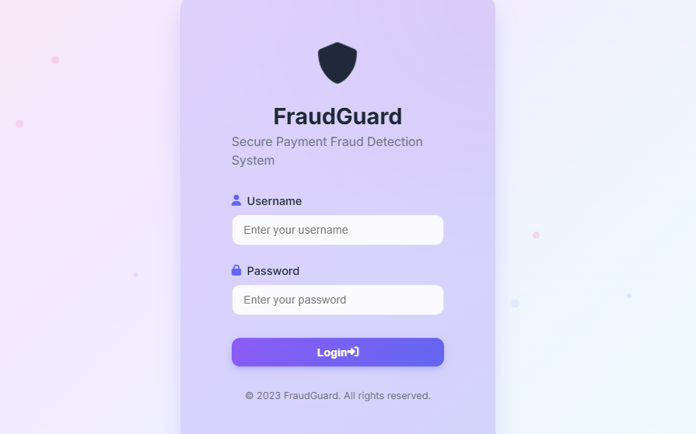
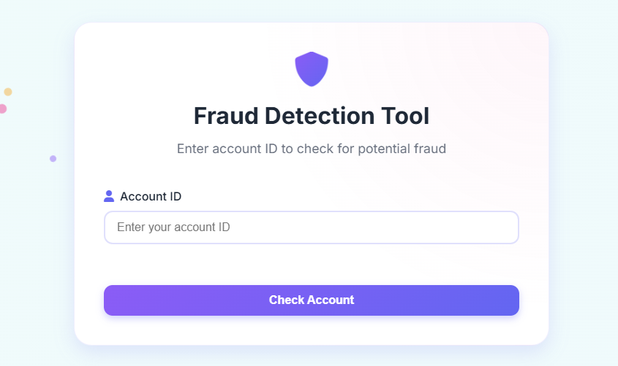
User Interface
Login Screen
Main Interface

Slide 9

Results and Benefits
94%
⚡
🔒
Precision
Real-Time
Secure
Early detection, reduced false positives, implementation simplicity.

Slide 10
Thank You
Created By: Sumit Parashar E23CSEU1080

